Slide 1

End of Year Project
Design and Production of a Cows Health Monitoring Platform
2021/2022
Presented by :
OUESLATI Med Zied
HAJJOUJI Omar
REJAIBI Kais
ELHAMMEMI Houssem
Examined by :
Mrs. BOHLI Nedra
Tutored by :
Mrs. HARBAOUI Imen

Slide 2
01
PROJECT SCOPE
02
STATE OF ART
03
PROPOSED SOLUTION
IMPLEMENTATION & FEATURES
04
05
RESULTS AND PERSPECTIVES

Slide 3
01
PROJECT SCOPE

Slide 4
What is Estrus and Estrus Detection ?
The Estrus ( commonly known as Heat ) comes with a multitude of behavioural and physiological changes notably:
A sudden increase in body temperature.
Lack of interest for food.
Mounting acceptance.
Stress and restlessness.
Estrus detection, in farms, consists in periodical observational monitoring of the cows and noting the abnormal behaviour to try and predict if the concerned cow is is experiencing estrus

Slide 5
Estrous Cycle
Estus:
Receptive Heat onset
01
03
3 to 4 DAYS
10h
18h
Pre-Estrus
Post-Estrus
02

Slide 6
Best Insemination Moments
Estrus
Start of Standing Heat
T = 0h
01
03
T+4h T+16h
Pre-Estrus
Post-Estrus
02
Optimal Window for Natural or Artificial Insemination

Slide 7
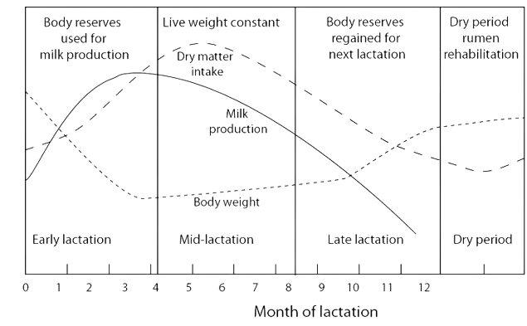
WHY THE INTEREST IN
ESTRUS DETECTION ?
Unexceptionally to other mammals, cows have to get pregnant and calve in order to produce milk.
After calving, peak milk production is atteignable or 2 to 3 months and the production stops after 12 months of the calve

Slide 8
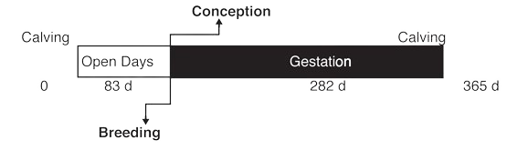
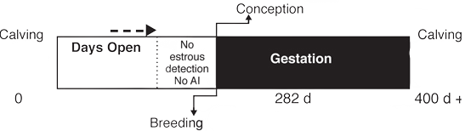
GESTATION CYCLE
Real Gestation

Slide 9
Estrus Detection Success Rate
50-60%
70-90%
Traditional Observation-Based Detection
Aids for Estrus Detection

Slide 10
02
STATE OF ART

Slide 11
State of The Art
Commercialized Solutions
Impacts
Notes:
Psychometrics is a field of study whose focus is on the underlying theory and the different
techniques related to psychological measurement namely personality traits, attitude, abilities,
values and interests.

Slide 12
Commercialized Solutions
91%
70%
84%
There are 3 main types of estrus detection aids solutions.
Glued-on indicators.
Self-adhesive indicators.
Electronic Monitoring.
Glued-on indicators:
ESTROTEC
Self-adhesive indicators:
KARMAR HEATMOUNT
Electronic Monitoring:
ACCUBREED

Slide 13
Impacts
55%
38.5%
80%
56%
Mean Traditional Observation-Based Detection
Chance of Conceiving During Estrus
X 70% Conceiving rate =
Chance of Conceiving During Estrus
Mean of Aid Based Detection
X 70% Conceiving rate =

Slide 14
03
PROPOSED SOLUTION
Notes:
Social media-predicted personality traits and values can help match people to their ideal jobs

Slide 15
Key Metrics:
Temperature: (38.3°C - 39°C) → increases by 1.5 to 2 °C
Activity: sedentary behaviour → hyperactivity
Ruminition: 8 hours a day → 2 hours a day

Slide 16
Product Overview:
Communication Protocols
Mobile Application
01
03
DataBase
Hardware Resources
02
04

Slide 17
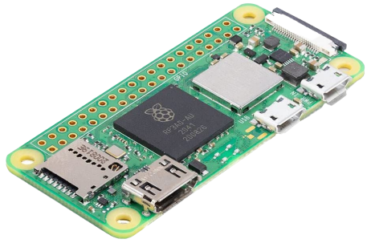
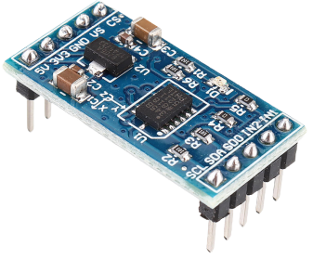
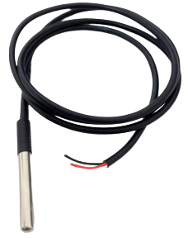
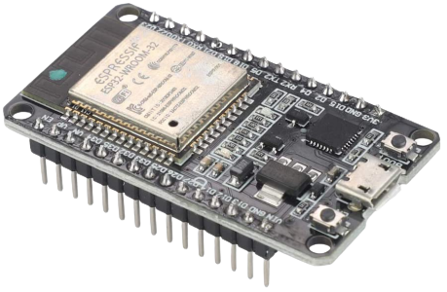
Hardware Resources:
Raspberry Pi Zero WH
ADXL345 Accelerometer
DS18B20 Temperature Sensor Cable
ESP32-WROOM32

Slide 18


Secure communication protocols:
Realtime DataBase:
HTTPS: Hyper Text Transfer Protocol Secure
Google FireBase

Slide 19
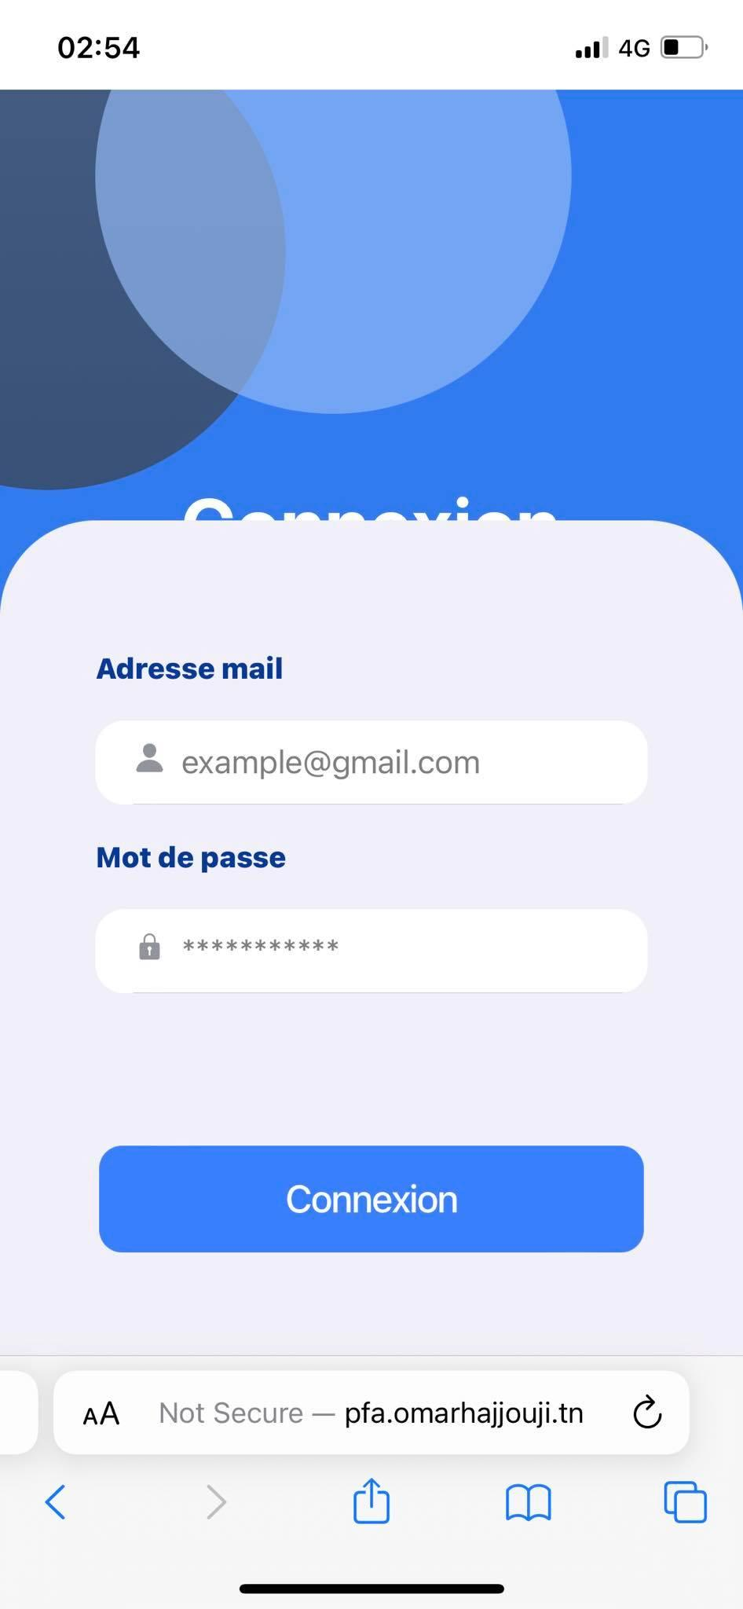
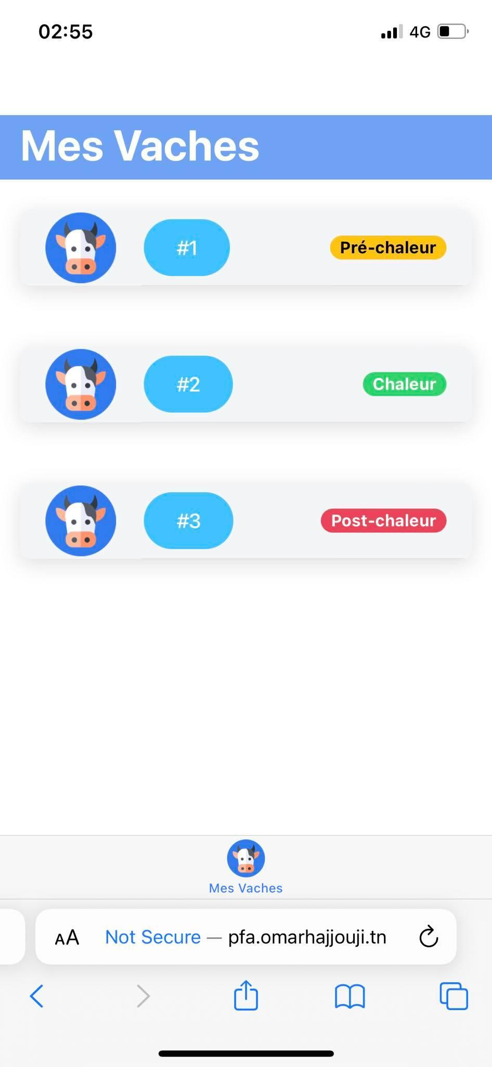
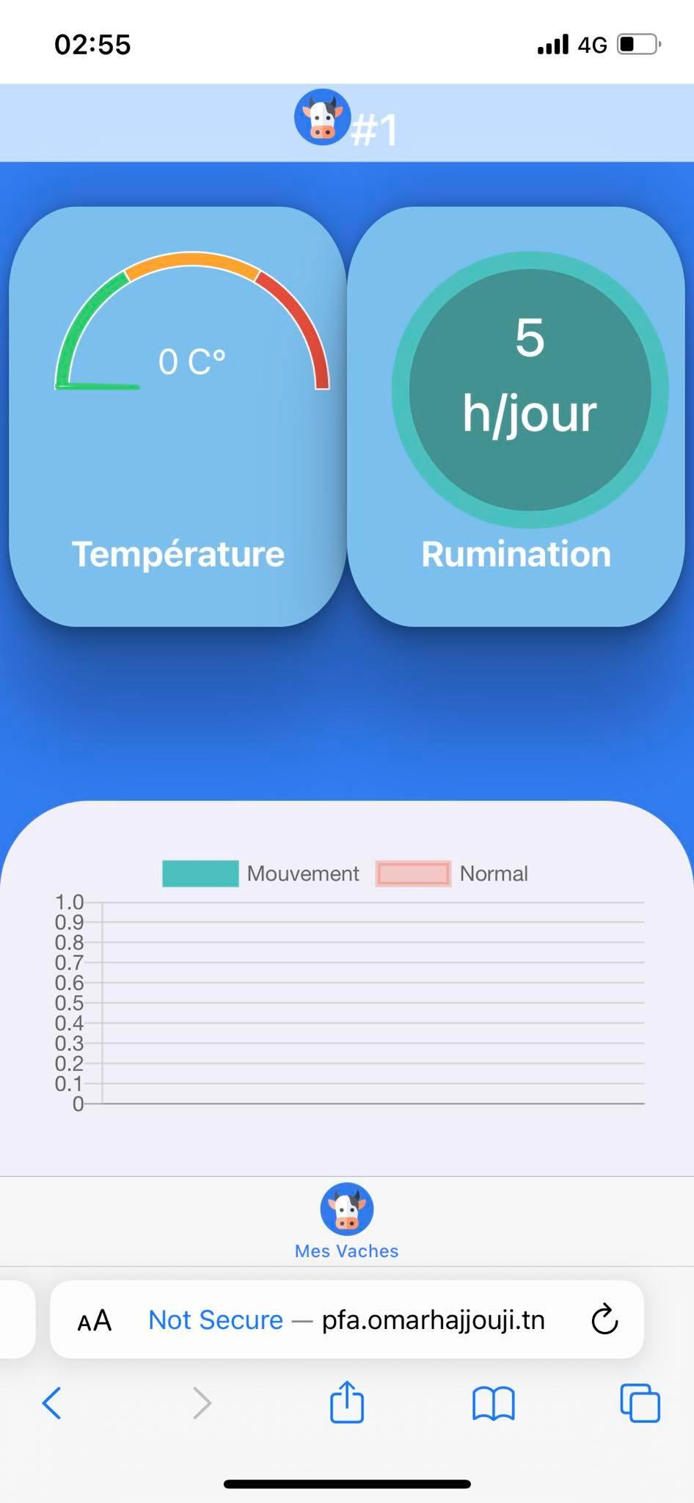
Mobile Application:

Slide 20
To sum up
Our product Cost: 60$ → 180DT
Existing solutions:
300$ → 900DT
Scalable
Warranty & After sales service
Easy to use

Slide 21
04
GENERAL ARCHITECTURE

Slide 22
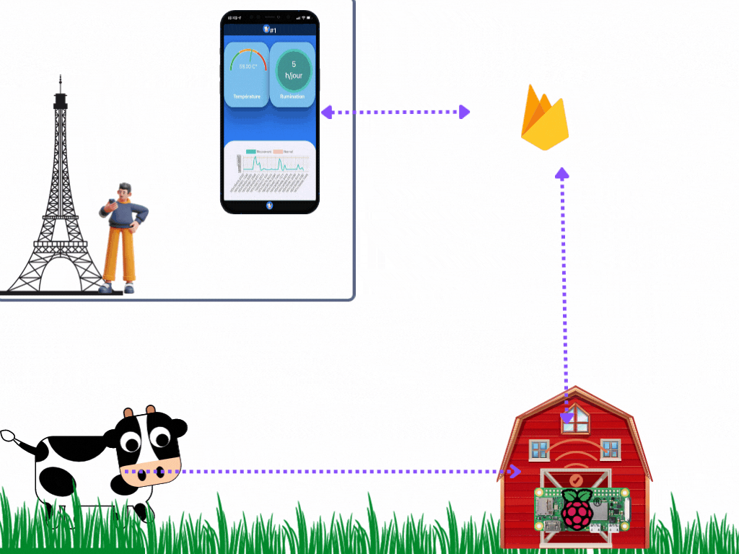
General Architecture

Slide 23


General Architecture
Collar Device
Temperature Sensor.
Accelerometer.
Wifi Equipped .

Slide 24




General Architecture
Central Hub
Local Server.
Web application.
Wifi Access Point.

Slide 25



General Architecture
Cloud Application
User Authentication.
Real Time Database.
Reliable System.

Slide 26


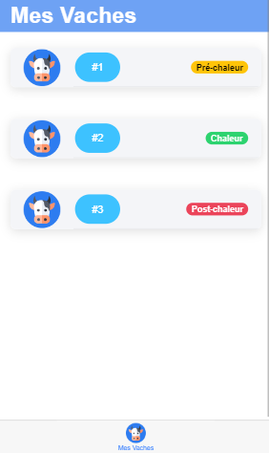
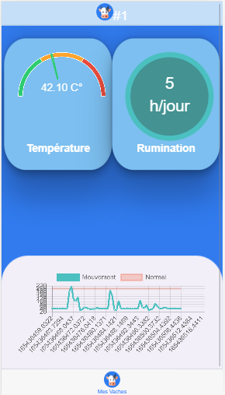


General Architecture
Mobile Application
Cows Listing.
Real time monitoring.
Notifications Receiving.

Slide 27



Slide 28
05
RESULTS AND PERSPECTIVES

Slide 29
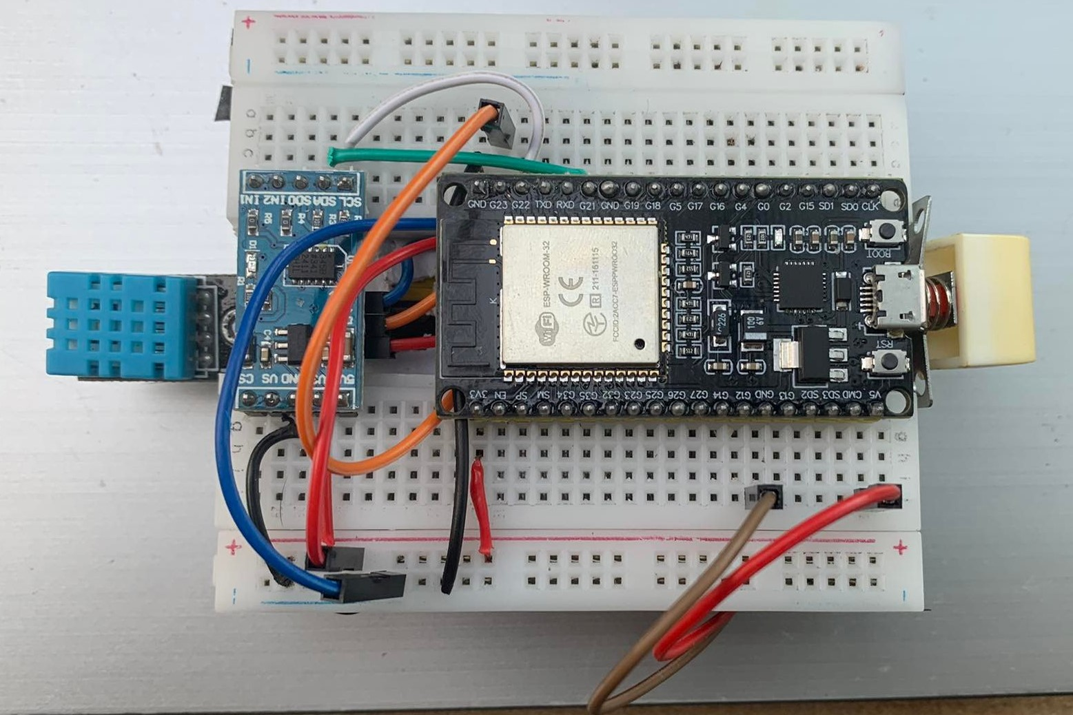
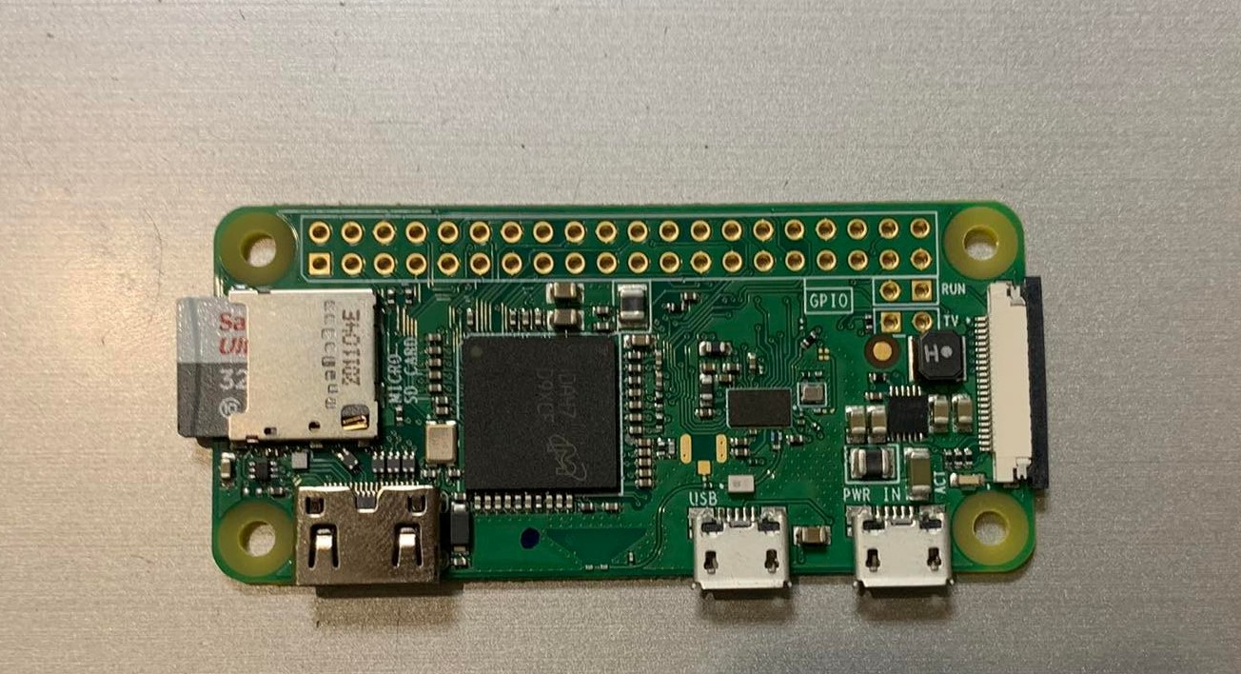
Built Prototype
ESP32 with hooked Sensors and Onboard Power Supply
Raspberry Pi 0 Board

Slide 30

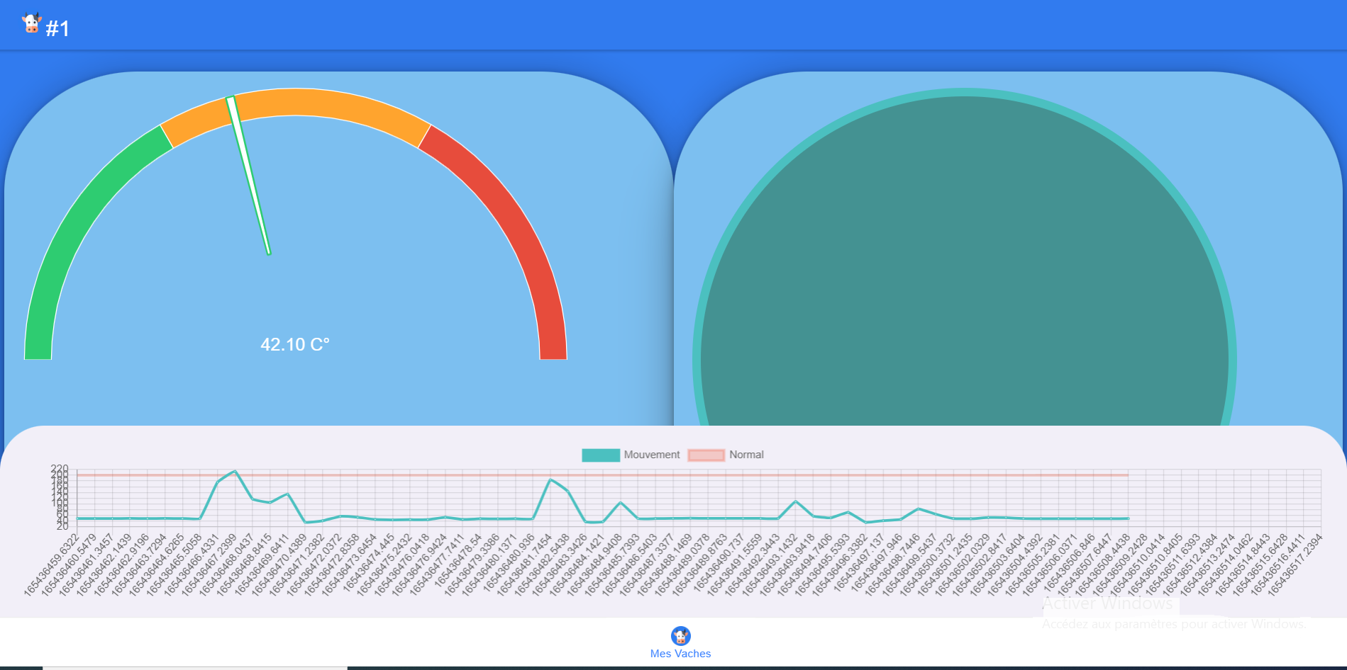
DESKTOP
WEB

Slide 31
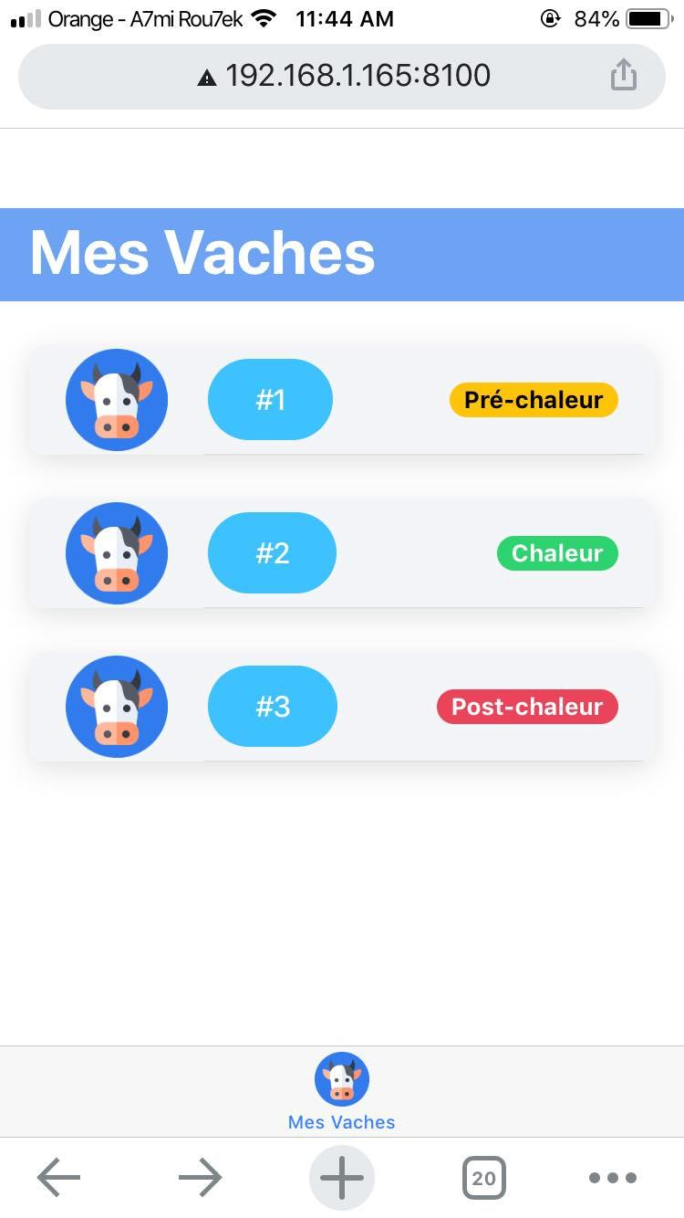
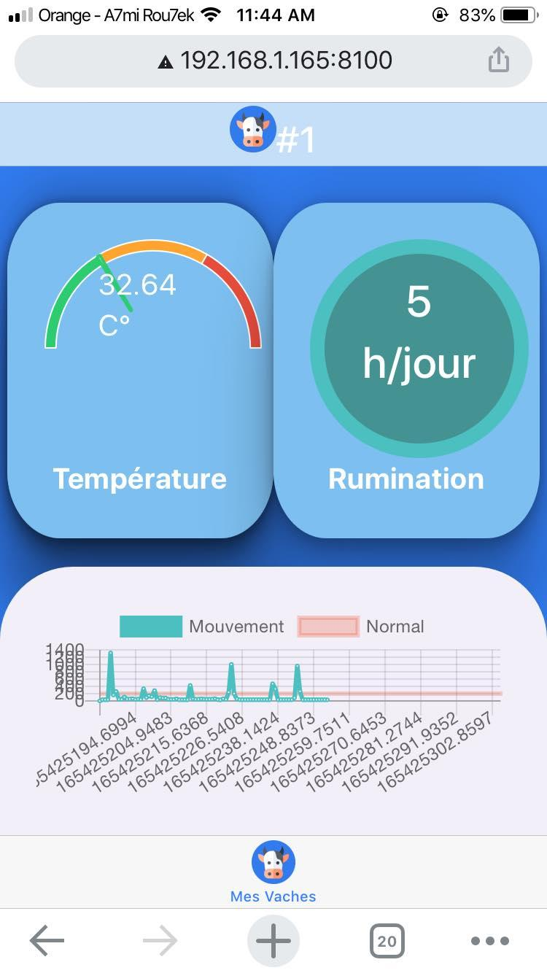
MOBILE WEB

Slide 32
PERSPECTIVES
PHOTOVOLTAIC PANELS FOR BETTER BATTERY LIFE
DISEASE DETECTION
GENERATING RELEVANT STATISTICS
NEW SENSOR ADDITIONS
MACHINE LEARNING-BASED PREDICTIONS
USE OF STM32 CARD FOR BETTER SCALABILITY

Slide 33

“Thanks For Your Attention!”
Scan the QR code to try the app
Email : test@gmail.com
Password : testpass

